Slide 1


Cannabis: Cash Crop or Crime Boom?
Alexander Fong
GitHub: WhimsicalNose03

Slide 2


Context:
Inspiration: https://bit.ly/2U9Wxii
Article alleges increased violent crime rates surrounding the legalization of Cannabis
Weed Pirates???

Slide 3
Process:
Data Collection: Collected data from several cities with varying degrees of legality
Data Cleaning and Visualization: Read data into Pandas and visualize with MatPlotLib
Hypothesis testing:
𝛼 = 0.05:
H(null): There is no significant change in these crime rates coinciding with the legalization of Cannabis
H(alt): There is a significant change in crime rates coinciding with the legalization of Cannabis

Slide 4
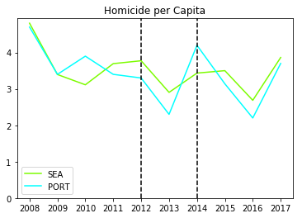
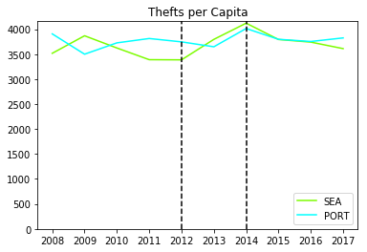
Homicide and Theft

Slide 5
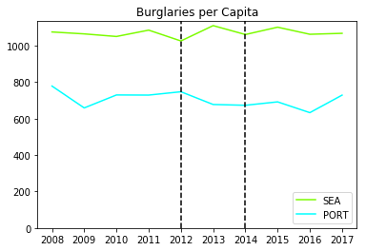
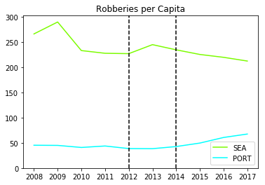
Burglary and Robbery

Slide 6


Results and Next Steps
Based on this data we cannot conclude that Weed Pirates are causing a significant increase in crime in all areas where cannabis is legal.
Next Steps:
Identify more Control Cities for Seattle
Evaluate other types of crime to see where legalization had an impact
Apply the same process to a different test city
Dig deeper into data to see if there are any trends by neighborhood

